Slide 1
MODEL MAKING 1
SEMESTER 6

Slide 2
Model making
For centuries, physical modeling has been a staple of Interior Design education and practice. Allowing the designer and client to explore a scheme in plan, elevation, and perspective all at once, the physical model aims to simulate the spatial relationship between volumes and to understand constructive systems.

Slide 3
Whether through a rapid, five-minute volumetric test of paper models, or a carefully sculpted timber construction detail, careful choice of material can greatly assist the modeling process, allowing designers to remain abstract, or test physical properties of structural systems.

Slide 4
Introduction to basic tools & materials used in model making
BASIC TOOLS
Scissors
Cutters
Cutting matt
Steel edge ruler
Masking tape
Thumb pins
Glue ( UHU or PVA)

Slide 5
Introduction to basic tools & materials used in model making
TYPES OF SHEETS
Scholar sheets
Balsa wood sheets
Corrugated sheets
Boxboard sheets
Cardboard sheets
Fomic sheet
Foam core or model making sheet

Slide 6
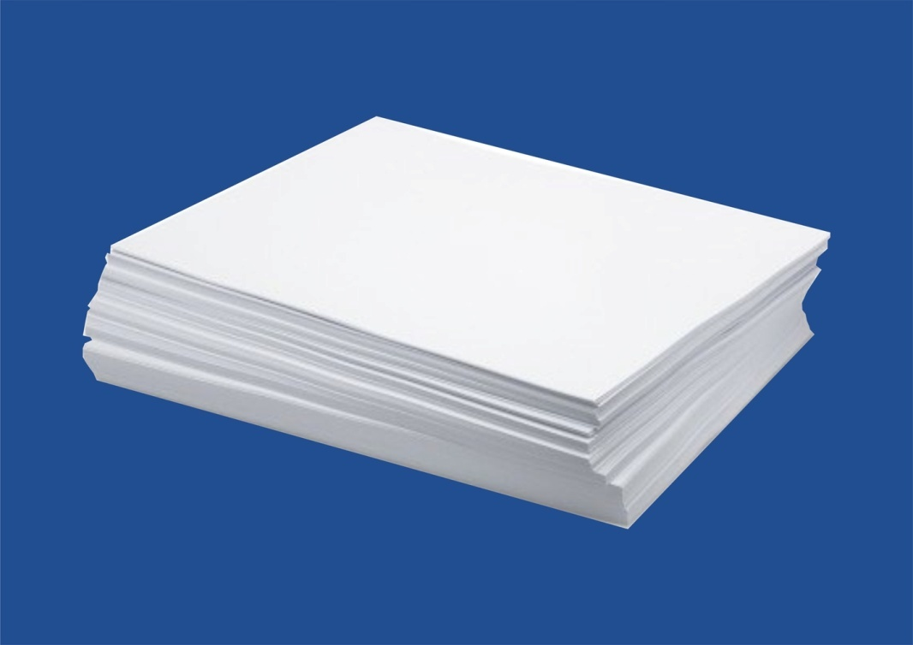
Scholar sheet
Thanks to its low cost and accessibility this material is most suitable for rapid volumetric testing or drawing of design plains. With scissors and some tape, you can generate a number of solutions quickly, easily, and cost-effectively, while still creating dynamic objects.
Another feature to be considered is the thinness and, consequently, flexibility of paper models, which allows stress-free bends, curves, and inclinations. This also makes the material good for folding studies.

Slide 7
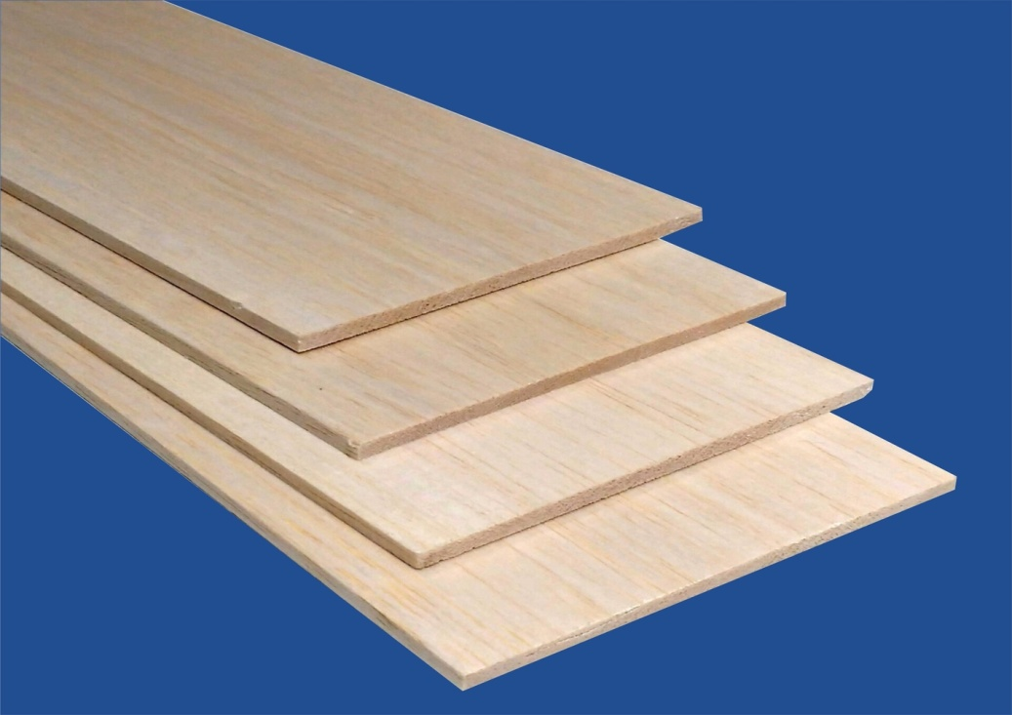
Balsa wood sheets
Within the family of wood used frequently in model making, Balsa is the one of the easiest to work with. The low thickness allows for precise cutting and joining of surfaces with wood or white glue. That being said, careful attention must be given when slicing perpendicular to the grain, to avoid chipping, or rough edges.

Slide 8
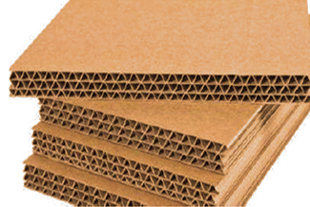
Corrugated sheet
Good for adding thickness
Easy to cut and glue together

Slide 9
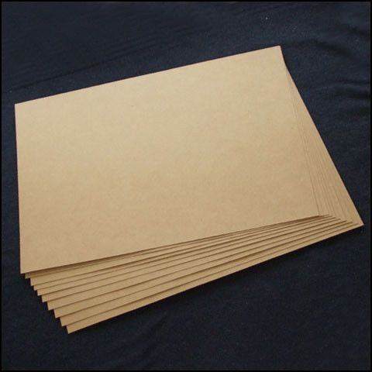
Boxboard sheet
Easily available
Gives a good finish
Easy to cut and paste
Easily foldable and makes fine corners
Can be used in making cubes or other forms

Slide 10
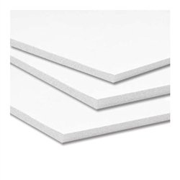
Foam board or model making sheet
Foam board has two thin layers of card sandwiching a layer of foam. Although the material it self is light, it does produce a reasonably strong model. It is easy to cut and will take most paints. Care should be taken when using adhesives as some will dissolve the foam core. It is generally found in 3 and 5mm thicknesses, but other sizes can be found.

Slide 11
PLASTIC SHEET
Transparent or frosted plastic sheets for making skylights or windows

Slide 12
OTHER MATERIALS
BAMBOO SKEWERS AND COCKTAIL STICKS
These are strong poles which can be used as fence posts, or even as scaffolding poles in the larger scales. They are sold in large cheap packs by supermarkets for barbecuing kebabs etc.
ICE CREAM STICKS
COTTON
FABRIC

